Slide 1
(Strategic Management)
Managing Strategy

Slide 2

Strategic Management
Colgate-Palmolive

Slide 3



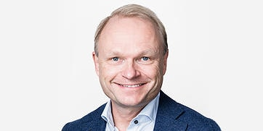

Who drives this?
Julie Sweet
Chief Executive Officer
Accenture
David L. Calhoun
Ex-President and
Chief Executive Officer
Boeing
Mr. Kumar Mangalam Birla
Chairman, Aditya Birla Group
You
Chief Executive Officer
XXX
Pekka Lundmark
Ex-President and
Chief Executive Officer Nokia
Gary C. Kelly
Ex-Chief Executive Officer
Southwest Airlines

Slide 4
Learning Objectives
Strategic management.
Six steps of the strategic management process.
Three types of corporate strategies.

Slide 5
Strategic Management
Strategic Management: a set of managerial decisions and actions that determines the long-run performance of a corporation.

Slide 6
Strategic Management
Firm performance depends both on the actions managers take and the context in which those actions are taken.
      Actions: Acquisition and deployment of firms assets
      Context: Internal & External factors
The Goal of Strategic Management is to provide the conceptual framework that will help a manager understand the key relationships among actions, context and performance.

Slide 7
Strategy
Strategy is about understanding what you do, looking out over the long-term future to determine what you want to become, and - most importantly - focusing on how you plan to get there.
Dictionary: Strategy is a plan, method, or a series of maneuvers or stratagems for obtaining a specific goal or result.
Management: Strategy is a plan or pattern that integrates an organization’s major goals, policies and action sequences into a cohesive whole.

Slide 8
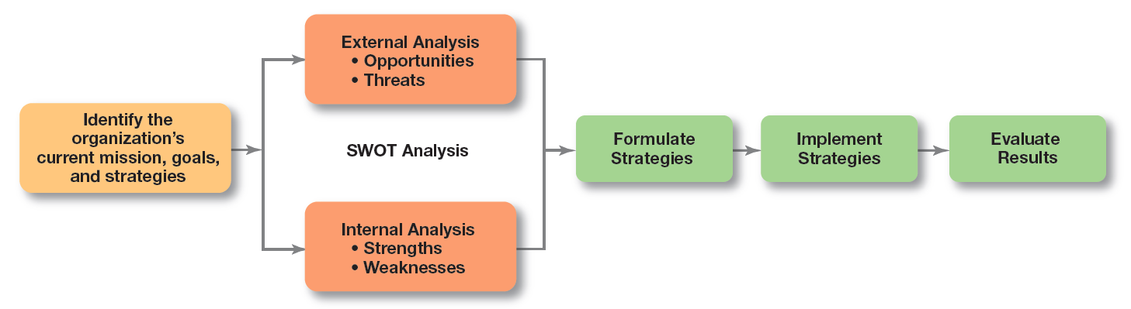
Strategic Management Process
A Six Step Process

Slide 9
Step 1: Identifying the Organization’s
Current Mission, Goals, and Strategies
Mission: the purpose of an organization
Notes:
Every organization needs a mission—a statement of its purpose. Defining the mission forces managers to identify what it’s in business to do. But sometimes that mission statement can be too limiting.

Slide 10
Components of a Mission Statement
Component | Question
Customers | Who are the firm’s customers?
Market | Where does the firm compete geographically?
Concern for Survival, Growth, and Profitability | Is the firm committed to growth and financial stability?
Philosophy | What are the firm’s basic beliefs, values, and ethical priorities?
Concern for Public Image | How responsive is the firm to societal and environmental concerns?
Products or Services | What are the firm’s major products or services?
Technology | Is the firm technologically current?
Self-Concept | What are the firm’s major competitive advantage and core competencies?
Concern for Employees | Are employees a valuable asset of the firm?

Slide 11
Step 2: Doing an External Analysis
Opportunities: positive trends in the external environment
Threats: negative trends in the external environment
Notes:
Analyzing that environment is a critical step in the strategic management process. Managers do an external analysis so they know, for instance, what the competition is doing, what pending legislation might affect the organization, or what the labor supply is like in locations where it operates. In an external analysis, managers should examine the economic, demographic, political/legal, sociocultural, technological, and global components to see the trends and changes.
Once they’ve analyzed the environment, managers need to pinpoint opportunities that the organization can exploit and threats that it must counteract or buffer against. Opportunities are positive trends in the external environment; threats are negative trends.

Slide 12
Step 3: Doing an Internal Analysis
Resources: an organization’s assets – financial, physical, human, and intangible - that are used to develop, manufacture, and deliver products to its customers.
Capabilities: an organization’s skills and abilities in doing the work activities needed in its business.
Core competencies: the organization’s major value- creating capabilities that determine its competitive weapons.
Culture and Structure of an organization also needs to be assessed.
Strengths: any activities the organization does well or its unique resources
Weaknesses: activities the organization does not do well or resources it needs but does not possess
Notes:
Now we move to the internal analysis, which provides important information about an organization’s specific resources and capabilities. An organization’s resources are its assets—financial, physical, human, and intangible—that it uses to develop, manufacture, and deliver products to its customers. They’re “what” the organization has. On the other hand, its capabilities are its skills and abilities in doing the work activities needed in its business—“how” it does its work. The major value-creating capabilities of the organization are known as its core competencies. Both resources and core competencies determine the organization’s competitive weapons.

Slide 13
SWOT Analysis
SWOT analysis: an analysis of the organization’s strengths, weaknesses, opportunities, and threats
Notes:
After completing an internal analysis, managers should be able to identify organizational strengths and weaknesses. Any activities the organization does well or any unique resources that it has are called strengths. Weaknesses are activities the organization doesn’t do well or resources it needs but doesn’t possess.
The combined external and internal analyses are called the SWOT analysis, an analysis of the organization’s strengths, weaknesses, opportunities, and threats. After completing the SWOT analysis, managers are ready to formulate appropriate strategies—that is, strategies that (1) exploit an organization’s strengths and external opportunities, (2) buffer or protect the organization from external threats, or (3) correct critical weaknesses.

Slide 14
Step 4: Formulating Strategies
Three main types of strategies managers will formulate:
  Corporate
  Competitive/business
  Functional
Notes:
As managers formulate strategies, they should consider the realities of the external environment and their available resources and capabilities in order to design strategies that will help an organization achieve its goals. The three main types of strategies managers will formulate include corporate, competitive, and functional. We’ll describe each shortly.

Slide 15
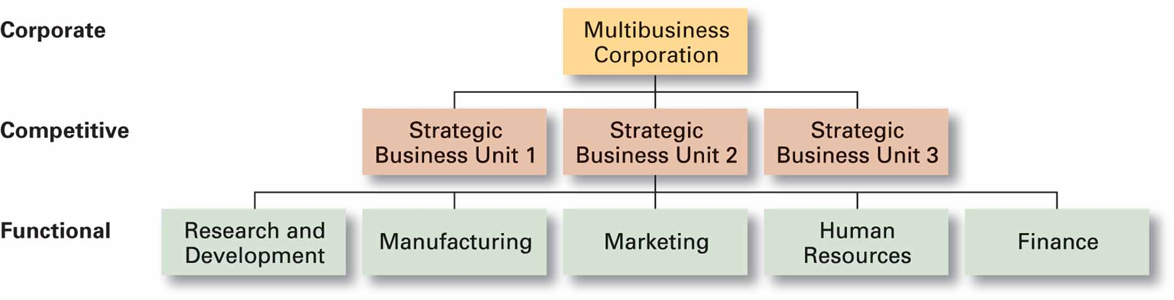
Hierarchy/Types of
Organizational Strategies

Slide 16
Step 5: Implementing Strategies
No matter how effectively an organization has planned its strategies, performance will suffer if the strategies aren’t implemented properly.
Developing Programs, Budgets and Procedures
Notes:
Once strategies are formulated, they must be implemented. No matter how effectively an organization has planned its strategies, performance will suffer if the strategies aren’t implemented properly.

Slide 17
Hierarchy/Types of
Organizational Strategies
Change in Structure
Appropriate staffing: right people in right number and at right place
Change in culture
Action plan

Slide 18
Step 6: Evaluating Results
How effective have strategies been at helping the organization achieve its goals
What adjustments are necessary?
Notes:
The final step in the strategic management process is evaluating results. How effective have the strategies been at helping the organization reach its goals? What adjustments are necessary?

Slide 19
What is Corporate Strategy?
Corporate strategy: an organizational strategy that determines what businesses a company is in or wants to be in, and what it wants to do with those businesses.
Three types of Corporate strategy are:
Growth Strategy
Stability Strategy
Renewal Strategy
Notes:
A corporate strategy is one that determines what businesses a company is in or wants to be in and what it wants to do with those businesses. It’s based on the mission and goals of the organization and the roles that each business unit of the organization will play.

Slide 20
What Are the Types of Corporate Strategy?
Growth strategy: a corporate strategy that’s used when an organization wants to expand the number of markets served or products offered, either through its current business(es) or through new business(es).
  Concentration
  Vertical integration
  Horizontal integration
  Diversification
Notes:
Organizations grow by using concentration, vertical integration, horizontal integration, or diversification.
An organization that grows using concentration focuses on its primary line of business and increases the number of products offered or markets served in this primary business.
A company also might choose to grow by vertical integration, either backward, forward, or both. In backward vertical integration, the organization becomes its own supplier so it can control its inputs.
In horizontal integration, a company grows by combining with competitors.
Finally, an organization can grow through diversification, either related or unrelated. Related diversification happens when a company combines with other companies in different, but related, industries. Unrelated diversification is when a company combines with firms in different and unrelated industries.

Slide 21
Growth strategy
  Concentration: focuses on primary line of business and increase the number of products offered and markets served in this primary business.
  Vertical integration: either backward or forward or both.
        In backward integration, the organization becomes its own supplier so it can control its inputs.
        In forward integration, the organization becomes its own distributor and is able to control its outputs.
Horizontal integration: A company grows by combining with competitors.
Diversification: either related or unrelated. Here basically, adding new business.

Slide 22
Stability and Renewal Strategies
Stability strategy: a corporate strategy in which an organization continues to do what it is currently doing. The organization doesn’t grow. But doesn’t fall behind, either.
Renewal strategy: a corporate strategy designed to address declining performance.
    Retrenchment strategy: short-term renewal strategy used for a minor performance problem.
    Turnaround Strategy: When organizations problems are more serious, more drastic action is needed.
    Managers do two things for renewal strategies: cut costs and restructure organizational operations.
Notes:
Examples of a stability strategy include continuing to serve the same clients by offering the same product or service, maintaining market share, and sustaining the organization’s current business operations. The organization doesn’t grow, but doesn’t fall behind, either.
Managers need to develop strategies, called renewal strategies, that address declining performance. The two main types of renewal strategies are retrenchment and turnaround strategies.

Slide 23
How Are Corporate Strategies Managed?
BCG matrix: a strategy tool that guides resource allocation decisions on the basis of market share and growth rate of SBUs
  Stars
  Cash cows
  Question marks
  Dogs
Notes:
When an organization’s corporate strategy encompasses a number of businesses, managers can manage this collection, or portfolio, of businesses using a tool called a corporate portfolio matrix. This matrix provides a framework for understanding diverse businesses and helps managers establish priorities for allocating resources. The first portfolio matrix—the BCG matrix—was developed by the Boston Consulting Group and introduced the idea that an organization’s various businesses could be evaluated and plotted using a 2 × 2 matrix to identify which ones offered high potential and which were a drain on organizational resources. The horizontal axis represents market share (low or high), and the vertical axis indicates anticipated market growth (low or high). A business unit is evaluated using a SWOT analysis and placed in one of the four categories listed.

Slide 24
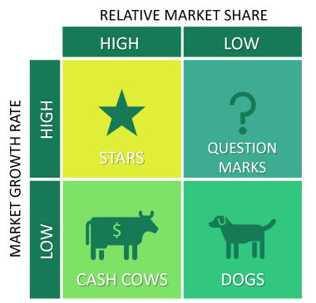
BCG Matrix

Slide 25
Competitive/Business Strategies
Notes:
For a small organization in only one line of business or a large organization that has not diversified into different products or markets, its competitive strategy describes how it will compete in its primary or main market. For organizations in multiple businesses, however, each business will have its own competitive strategy that defines its competitive advantage, the products or services it will offer, the customers it wants to reach, and the like.
When an organization is in several different businesses, those single businesses that are independent and that have their own competitive strategies are referred to as strategic business units (SBUs).

Slide 26
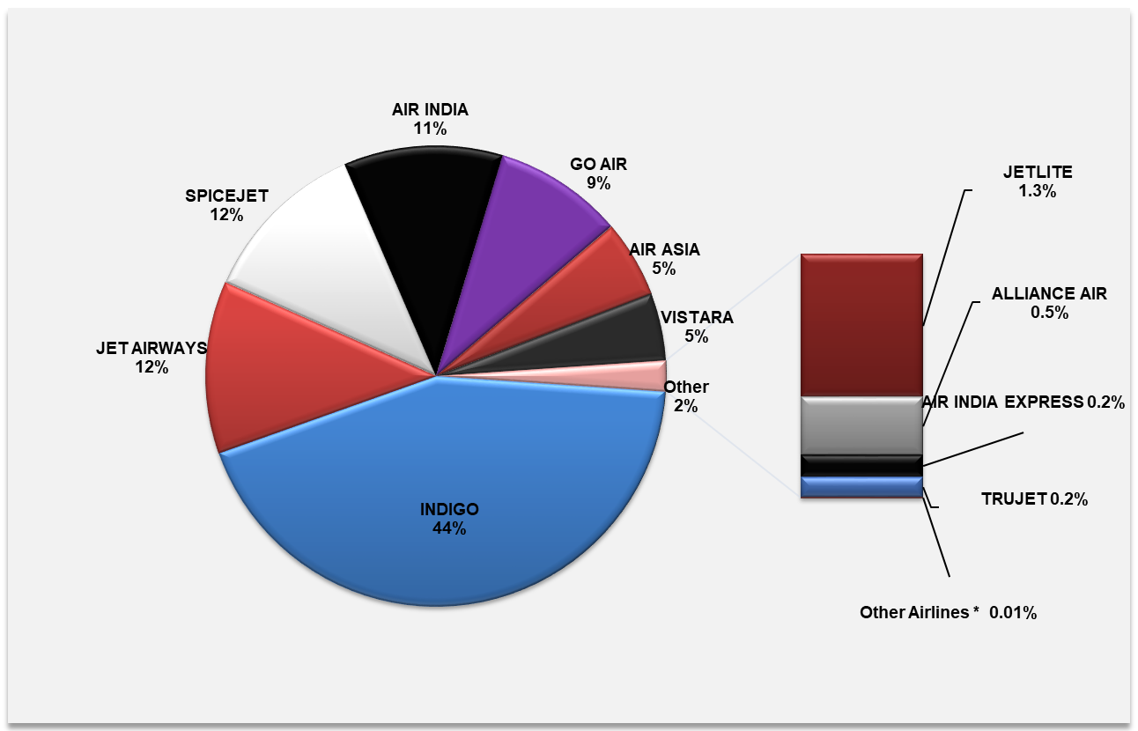
MARKET SHARE (%) IN TERMS OF
DOMESTIC MARKET DEMAND in 2018-19

Slide 27
Competitive/Business Strategies
Competitive strategy: an organizational strategy for how an organization will compete in its business(es)
Strategic business unit (SBU): the single independent businesses of an organization that formulate their own competitive strategies
Competitive advantage: What sets an organization apart; its distinctive edge
Notes:
For a small organization in only one line of business or a large organization that has not diversified into different products or markets, its competitive strategy describes how it will compete in its primary or main market. For organizations in multiple businesses, however, each business will have its own competitive strategy that defines its competitive advantage, the products or services it will offer, the customers it wants to reach, and the like.
When an organization is in several different businesses, those single businesses that are independent and that have their own competitive strategies are referred to as strategic business units (SBUs).

Slide 28
Sustaining Competitive Advantage
Porter’s Five Forces Model:
  Threat of new entrants
  Threat of substitutes
  Bargaining power of buyers
  Bargaining power of suppliers
  Current rivalry
Notes:
Many important ideas in strategic management have come from the work of Michael Porter. One of his major contributions was explaining how managers can create a sustainable competitive advantage. An important part of doing this is an industry analysis, which is done using the five forces model.
In any industry, five competitive forces dictate the rules of competition. Together, these five forces determine industry attractiveness and profitability, which managers assess using the five factors listed.

Slide 29
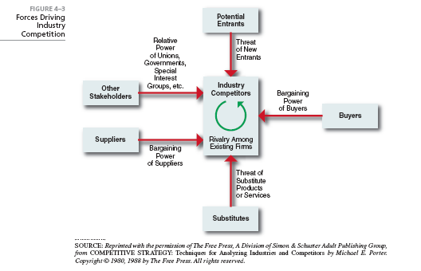
Industry Analysis:
Porter’s 5 Force Analysis

Slide 30
Choosing a Competitive Strategy
Cost leadership strategy: competes on the basis of having lowest costs (costs or expenses, not prices) in its Industry.
Differentiation strategy: competes by offering unique products that are widely valued by customers. Product differences might come from exceptionally high quality, extraordinary service, innovative design, technological capability, or an unusually positive brand image.
Focus strategy: Cost focus or differentiation focus in a narrow segment or niche.
Blue Ocean Strategy – Value Innovation (Both Cost leadership and Differentiation)
Notes:
When an organization competes on the basis of having the lowest costs (costs or expenses, not prices) in its industry, it’s following a cost leadership strategy. A low-cost leader is highly efficient. Overhead is kept to a minimum, and the firm does everything it can to cut costs.
A company that competes by offering unique products that are widely valued by customers is following a differentiation strategy. Product differences might come from exceptionally high quality, extraordinary service, innovative design, technological capability, or an unusually positive brand image. Practically any successful consumer product or service can be identified as an example of the differentiation strategy.
Although these two competitive strategies are aimed at the broad market, the final type of competitive strategy—the focus strategy—involves a cost advantage (cost focus) or a differentiation advantage (differentiation focus) in a narrow segment or niche. Segments can be based on product variety, customer type, distribution channel, or geographical location.
What happens if an organization can’t develop a cost or a differentiation advantage? Porter called that being stuck in the middle and warned that’s not a good place to be. An organization becomes stuck in the middle when its costs are too high to compete with the low-cost leader or when its products and services aren’t differentiated enough to compete with the differentiator. Getting unstuck means choosing which competitive advantage to pursue and then doing so by aligning resource, capabilities, and core competencies.

Slide 31
Functional Strategies
Functional strategies: a strategy used by an organization’s various functional departments to support the competitive strategy.
Notes:
We don’t cover specific functional strategies in this book because you’ll cover them in other business courses you take.

Slide 32
The Need for Strategic Leadership
Strategic leadership: the ability to anticipate, envision, maintain flexibility, think strategically, and work with others in the organization to initiate changes that will create a viable and valuable future for the organization.
Notes:
By definition, top managers are ultimately responsible for every decision and action of every organizational employee. One important role that top managers play is that of strategic leader. Organizational researchers study leadership in relation to strategic management because an organization’s top managers must provide effective strategic leadership.

Slide 33
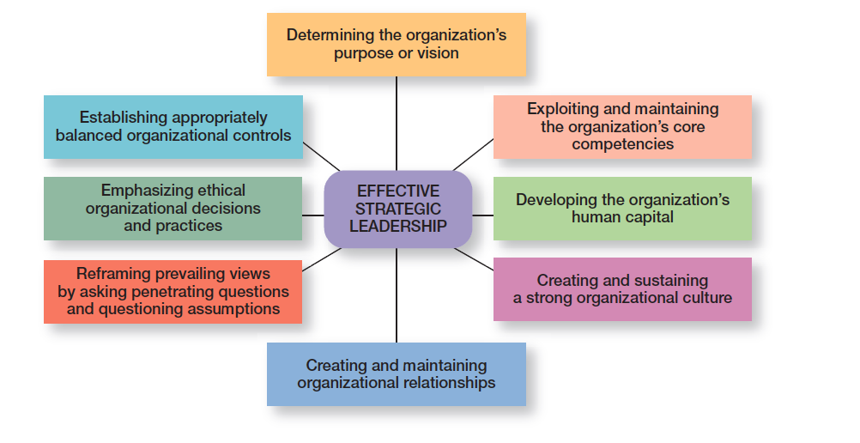
Effective Strategic Leadership

Slide 34
The Need for Strategic Flexibility
Strategic flexibility: the ability to recognize major external changes, to quickly commit resources, and to recognize when a strategic decision was a mistake
Notes:
Strategic flexibility is the ability to recognize major external changes, to quickly commit resources, and to recognize when a strategic decision isn’t working. Given the highly uncertain environment that managers face today, strategic flexibility seems absolutely necessary!

Slide 35
Developing Strategic Flexibility
Technique
Encourage leadership unity by making sure everyone is on the same page.
Keep resources fluid and move them as circumstances warrant.
Have the right mindset to explore and understand issues and challenges.
Know what’s happening with strategies currently being used by monitoring and measuring results.
Encourage employees to be open about disclosing and sharing negative information.
Get new ideas and perspectives from outside the organization.
Have multiple alternatives when making strategic decisions.
Learn from mistakes.

Slide 36
Thank you

